Slide 1
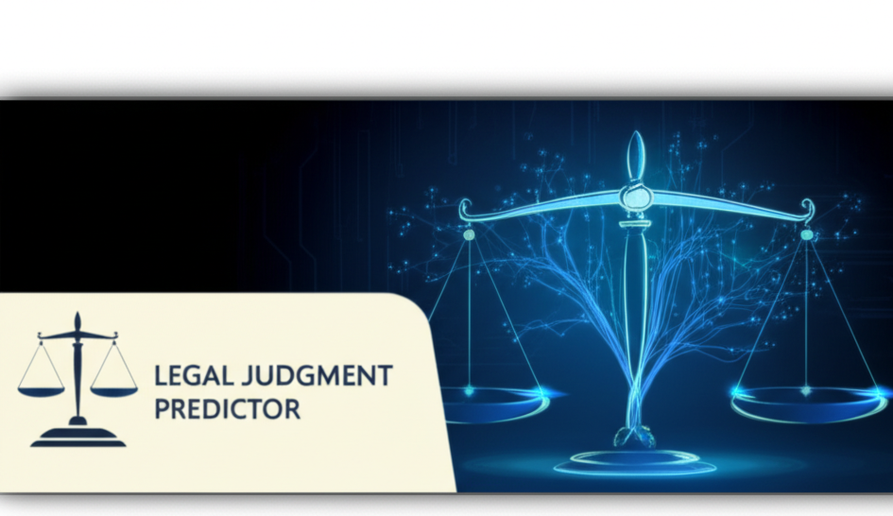

Slide 2

⚖️ Legal Judgment Predictor
An AI-Powered Legal Recommendation System
Presented by: Mehwish, A.Qadeer, M.Usman

Slide 3

Project Objective
Predict multiple legal outcomes based on user-provided case information
1
Provide intelligent assistance in legal decision-making
2
Make legal guidance accessible through a simple and effective interface
3

Slide 4
System Overview
Input: Case Facts, Evidence, Precedents, Prior Convictions
Backend: ML model with text vectorization and multi-label classification
Output: Legal Issue, Punishment, Articles, Judgment, Reasoning

Slide 5
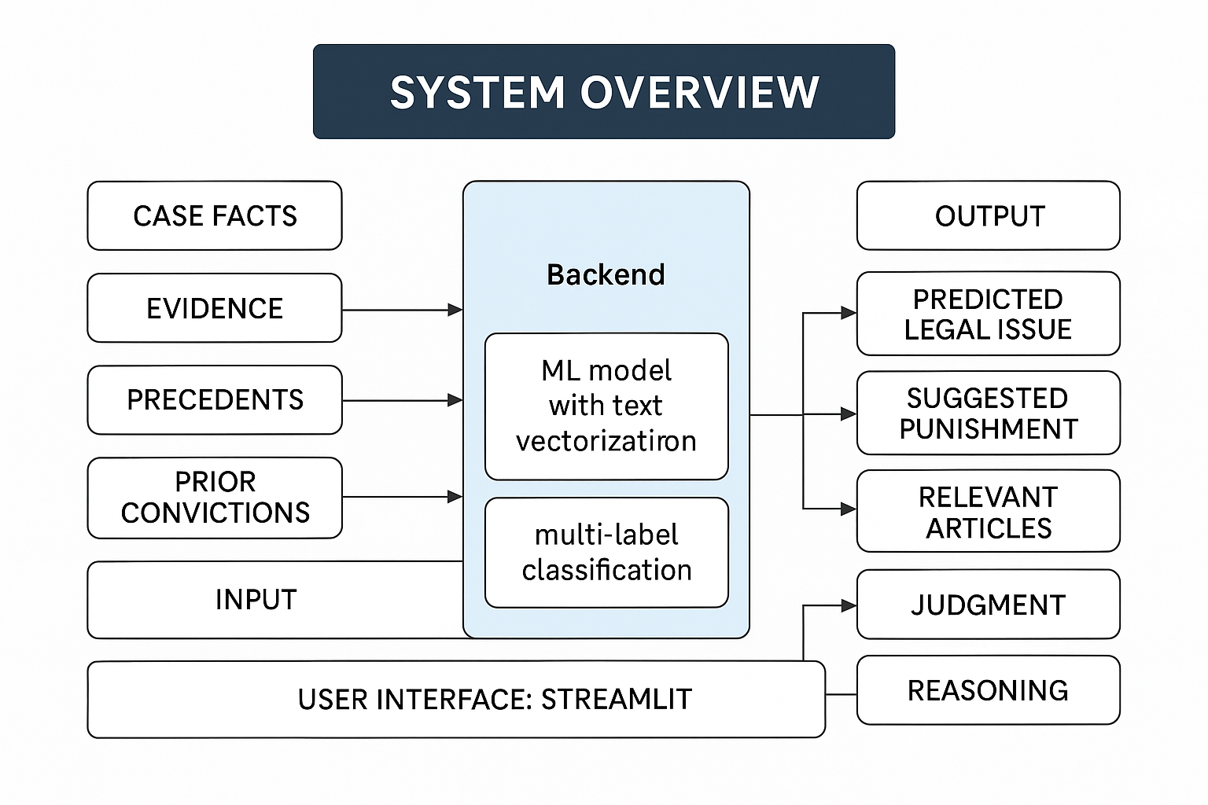

Slide 6
Technologies Used
Python
Streamlit – user interface
pandas – data loading and preprocessing
scikit-learn – vectorization and model building
joblib – model persistence
Excel dataset (.xlsx) – training data

Slide 7
Data Processing Flow
Load
Load Excel file using pandas
Fill
Fill missing values, convert to strings
Combine
Combine input fields into single text string
Apply
Apply TF-IDF vectorization

Slide 8
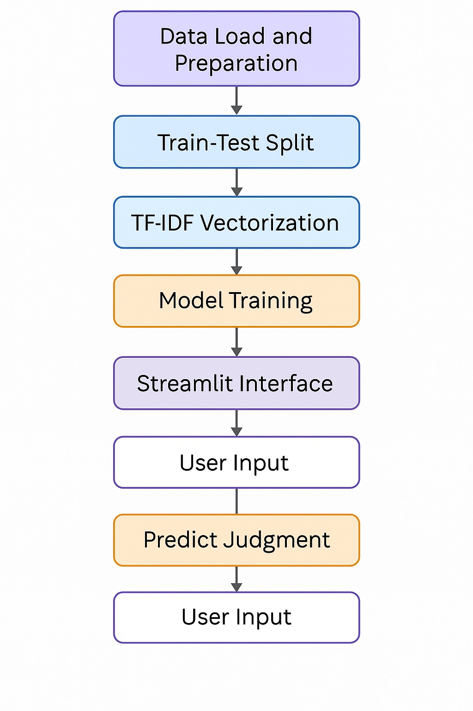

Slide 9
Machine Learning Model
Model: MultiOutputClassifier
Base: RandomForestClassifier
Input: TF-IDF matrix of case details
Output: Five predicted fields (multi-label classification)

Slide 10
Streamlit Web Application
Clean UI with text areas for input
Styled Predict button using CSS
Displays results clearly using markdown
Includes error handling and loading indicators

Slide 11
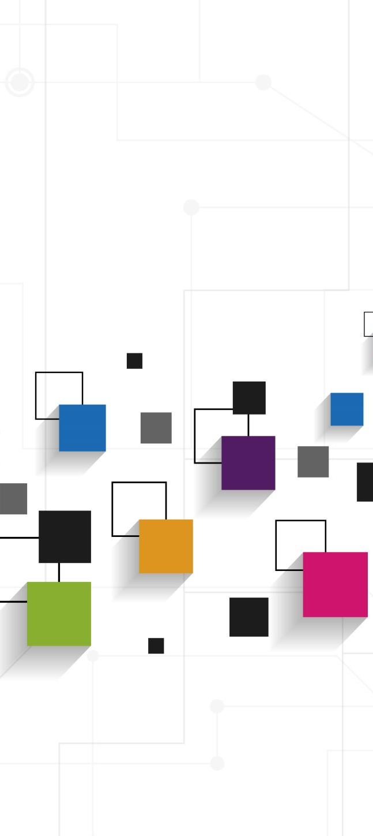
Prediction Workflow
User Inputs Data:
Text areas to enter case details (e.g., facts, evidence, precedents).
System Vectorizes and Aligns Input:
The text is processed and transformed into numerical data using techniques
like TF-IDF (Term Frequency-Inverse Document Frequency)
to match the model's trained feature set.
Model Makes Predictions:
The trained machine learning model (Random Forest Classifier)
generates predictions for various legal categories
(e.g., legal issue, punishment, relevant articles).
Results Displayed:
The predictions (Legal Issue, Judgment, Suggested Punishment, etc.)
are shown clearly on the interface, with headings for each prediction.

Slide 12
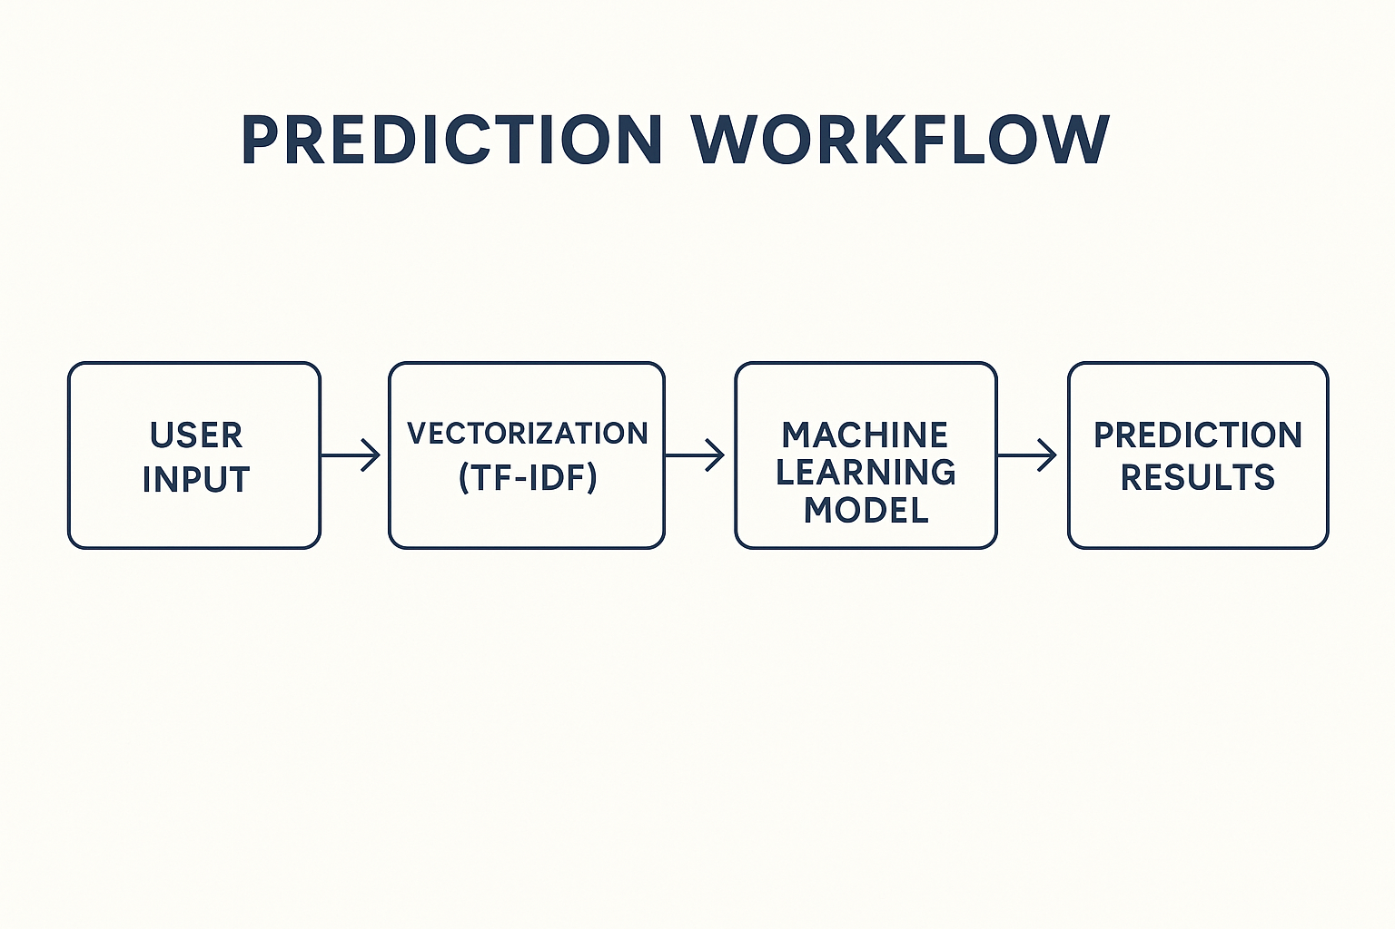

Slide 13
Application Benefits
Streamlined legal decision support tool
Handles multiple legal predictions
No technical knowledge required
Reduces manual research time
Useful for students, lawyers, researchers

Slide 14
Future Enhancements
Add transformer models like BERT
Integrate live legal document databases
Show prediction confidence scores
Enable document uploads (PDF, Word)
Add charts and dashboards

Slide 15
Conclusion
AI assistant for legal reasoning
Simple UI, powerful backend
Strong potential for real-world use

